Slide 1
ELEMENTS OF COMPUTING SYSTEMS - 1
GROUP-5
2024-2025

Slide 2
PART -A
Design and implement 16-bit HACK CPU
PART -B
Design and implement a synchronous counter that count down from decimal digit 9 onwards to 0
TEAMMATES
CHAITANYA VARMA – CB.SC.U4AIE24017
HARSHITH REDDY – CB.SC.U4AIE24018
JISHNU TEJA DANDAMUDI – CB.SC.U4AIE24019
JIVITES DAMODAR – CB.SC.U4AIE24020

Slide 3
PART -A
Design and implement 16-bit HACK CPU

Slide 4
WHAT IS HACK CPU?
The HACK CPU has the following key features:
16-bit word size: The CPU processes data in 16-bit chunks.
Registers: It includes a program counter (PC), instruction register (IR), and a set of general-purpose registers (R0 to R7).
ALU: An Arithmetic Logic Unit to perform arithmetic and logical operations.
Memory: Support for RAM and ROM.
Input/Output: Basic I/O operations through the RAM.

Slide 5
Components
a. Registers
Program Counter (PC): Points to the address of the next instruction.
Instruction Register (IR): Holds the current instruction being executed.
General-purpose registers (R0 to R7): For temporary data storage.
b. ALU Operations
The ALU supports several operations, such as:
Addition
Subtraction
Bitwise AND, OR, NOT
c. Control Unit
Decodes instructions and controls the execution of operations.
d. Memory
RAM: Stores data and instructions.
ROM: Stores the program to be executed.

Slide 6
GATES NEED TO BUILD 16 BIT HACK CPU
And
Or
Not
And16
Or16
Not16
Or8Way
Mux
Mux16
Xor
Or16Way
Full Adder
Half Adder
Add16
Inc16
ALU
Bit
Register
PC
CPU

Slide 7
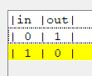
NOT
CHIP Not
{
IN in;
OUT out;
PARTS:
Nand(a=in, b=in, out=out);
}

Slide 8
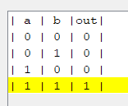
AND
CHIP And
{
IN a, b;
OUT out;
PARTS:
Nand(a=a, b=b, out=temp); Not(in=temp, out=out);
}

Slide 9
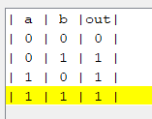
OR
CHIP Or
{
IN a, b;
OUT out;
PARTS:
Not(in=a, out=nota);
Not(in=b, out=notb);
Nand(a=nota, b=notb, out=out);
}

Slide 10
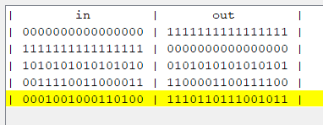
NOT16
CHIP Not16
{
IN in[16];
OUT out[16];
PARTS:
Not(in=in[0], out=out[0]);
Not(in=in[1], out=out[1]);
Not(in=in[2], out=out[2]);
Not(in=in[3], out=out[3]);
Not(in=in[4], out=out[4]);
Not(in=in[5], out=out[5]);
Not(in=in[6], out=out[6]);
Not(in=in[7], out=out[7]);
Not(in=in[8], out=out[8]);
Not(in=in[9], out=out[9]);
Not(in=in[10], out=out[10]);
Not(in=in[11], out=out[11]);
Not(in=in[12], out=out[12]);
Not(in=in[13], out=out[13]);
Not(in=in[14], out=out[14]);
Not(in=in[15], out=out[15]);
}

Slide 11
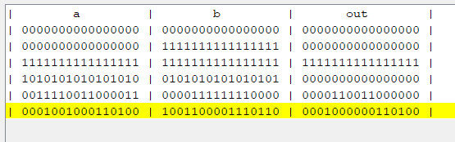
AND16
CHIP And16
{
IN a[16], b[16];
OUT out[16];
PARTS:
And(a=a[0], b=b[0], out=out[0]);
And(a=a[1], b=b[1], out=out[1]);
And(a=a[2], b=b[2], out=out[2]);
And(a=a[3], b=b[3], out=out[3]);
And(a=a[4], b=b[4], out=out[4]);
And(a=a[5], b=b[5], out=out[5]);
And(a=a[6], b=b[6], out=out[6]);
And(a=a[7], b=b[7], out=out[7]);
And(a=a[8], b=b[8], out=out[8]);
And(a=a[9], b=b[9], out=out[9]);
And(a=a[10], b=b[10], out=out[10]);
And(a=a[11], b=b[11], out=out[11]);
And(a=a[12], b=b[12], out=out[12]);
And(a=a[13], b=b[13], out=out[13]);
And(a=a[14], b=b[14], out=out[14]);
And(a=a[15], b=b[15], out=out[15]);
}

Slide 12
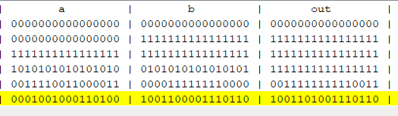
OR16
CHIP Or16
{
IN a[16], b[16];
OUT out[16];
PARTS:
Or(a=a[0], b=b[0], out=out[0]);
Or(a=a[1], b=b[1], out=out[1]);
Or(a=a[2], b=b[2], out=out[2]);
Or(a=a[3], b=b[3], out=out[3]);
Or(a=a[4], b=b[4], out=out[4]);
Or(a=a[5], b=b[5], out=out[5]);
Or(a=a[6], b=b[6], out=out[6]);
Or(a=a[7], b=b[7], out=out[7]);
Or(a=a[8], b=b[8], out=out[8]);
Or(a=a[9], b=b[9], out=out[9]);
Or(a=a[10], b=b[10], out=out[10]);
Or(a=a[11], b=b[11], out=out[11]);
Or(a=a[12], b=b[12], out=out[12]);
Or(a=a[13], b=b[13], out=out[13]);
Or(a=a[14], b=b[14], out=out[14]);
Or(a=a[15], b=b[15], out=out[15]);
}

Slide 13
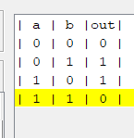
XOR
CHIP Xor
{
IN a, b;
OUT out;
PARTS:
Not(in=a, out=nota);
Not(in=b, out=notb);
And(a=a, b=notb, out=w1);
And(a=nota, b=b, out=w2);
Or(a=w1, b=w2, out=out);
}

Slide 14
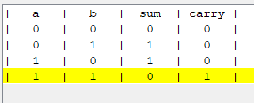
HALFADDER
CHIP HalfAdder
{
IN a, b; // 1-bit inputs
OUT sum, // Right bit of a + b
carry; // Left bit of a + b
PARTS:
Xor(a=a, b=b, out=sum);
And(a=a, b=b, out=carry);
}

Slide 15
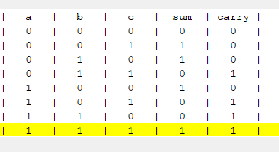
FULLADDER
CHIP FullAdder
{
IN a, b, c; // 1-bit inputs
OUT sum, // Right bit of a + b + c
carry; // Left bit of a + b + c
PARTS:
HalfAdder(a=a, b=b, sum=w1, carry=c1);
HalfAdder(a=w1, b=c, sum=sum, carry=c2);
Or(a=c1, b=c2, out=carry);
}

Slide 16
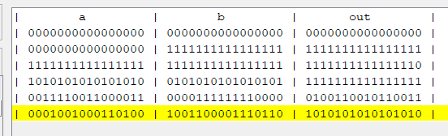
ADD16
CHIP Add16
{
IN a[16], b[16];
OUT out[16];
PARTS:
HalfAdder(a=a[0], b=b[0], sum=out[0], carry=c1);
FullAdder(a=a[1], b=b[1], c=c1, sum=out[1], carry=c2);
FullAdder(a=a[2], b=b[2], c=c2, sum=out[2], carry=c3);
FullAdder(a=a[3], b=b[3], c=c3, sum=out[3], carry=c4);
FullAdder(a=a[4], b=b[4], c=c4, sum=out[4], carry=c5);
FullAdder(a=a[5], b=b[5], c=c5, sum=out[5], carry=c6);
FullAdder(a=a[6], b=b[6], c=c6, sum=out[6], carry=c7);
FullAdder(a=a[7], b=b[7], c=c7, sum=out[7], carry=c8);
FullAdder(a=a[8], b=b[8], c=c8, sum=out[8], carry=c9);
FullAdder(a=a[9], b=b[9], c=c9, sum=out[9], carry=c10);
FullAdder(a=a[10], b=b[10], c=c10, sum=out[10], carry=c11);
FullAdder(a=a[11], b=b[11], c=c11, sum=out[11], carry=c12);
FullAdder(a=a[12], b=b[12], c=c12, sum=out[12], carry=c13);
FullAdder(a=a[13], b=b[13], c=c13, sum=out[13], carry=c14);
FullAdder(a=a[14], b=b[14], c=c14, sum=out[14], carry=c15);
FullAdder(a=a[15], b=b[15], c=c15, sum=out[15]);
}

Slide 17
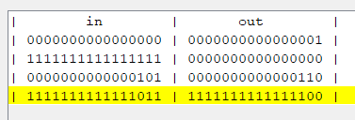
INC16
CHIP Inc16
{
IN in[16];
OUT out[16];
PARTS:
Add16(a=in, b[0]=true, b[1..15]=false, out=out);
}

Slide 18
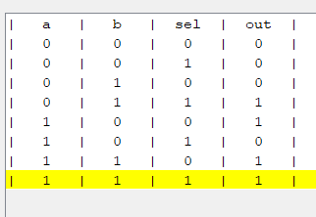
MUX
CHIP Mux {
IN a, b, sel;
OUT out;
PARTS:
Not(in=sel, out=notsel);
And(a=a, b=notsel, out=t1);
And(a=b, b=sel, out=t2);
Or(a=t1, b=t2, out=out);}

Slide 19

CENTRAL PROCESSING UNIT

Slide 20
WHAT IS CPU?
The CPU is the brain of a computer, containing all the circuitry needed to process input, store data, and output results.
The CPU is constantly following instructions of computer programs that tell it which data to process and how to process it. Without a CPU, we could not run programs on a computer.
The CPU can process those instructions easily, thanks to a control unit that knows how to interpret program instructions and an Arithmetic Logic Unit (ALU) that knows how to add numbers. With the control unit and ALU combined, the CPU can process much more complex programs than a simple calculator.

Slide 21
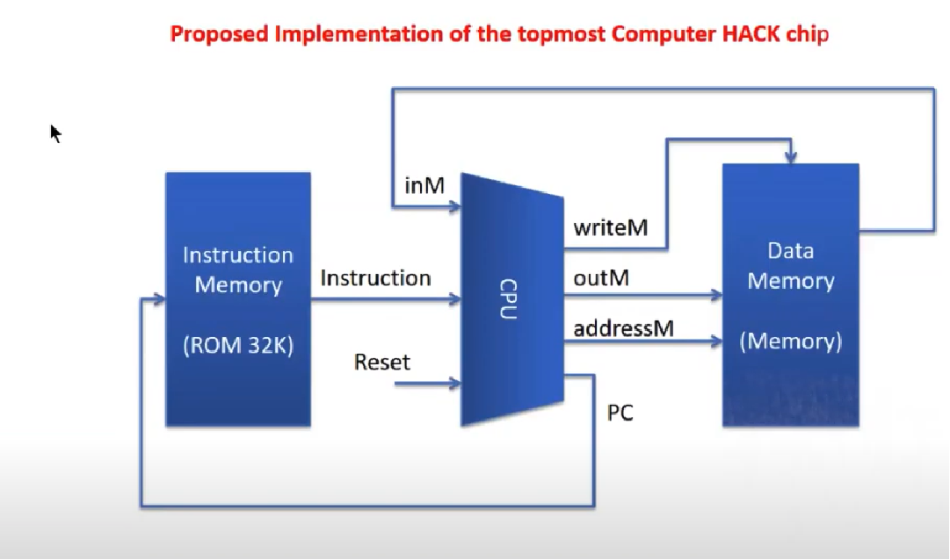
Proposed implementation of the top most computer hack chip

Slide 22
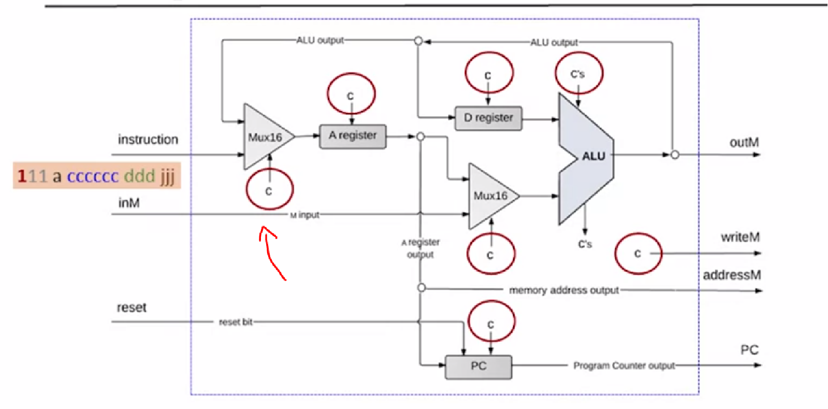

CENTRAL PROCESSING UNIT

Slide 23
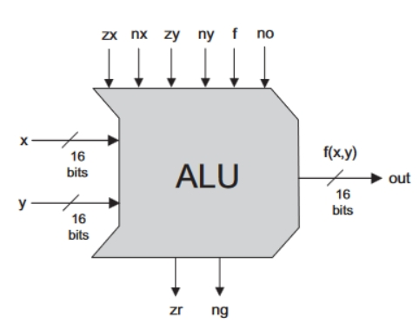
ALU
The Hack ALU computes a fixed set of functions on given two 16-bit inputs, out of which the function can be one of the possible eighteen functions.
We instruct the ALU which function to compute using six input bits, called control bits to the selected binary values.

Slide 24
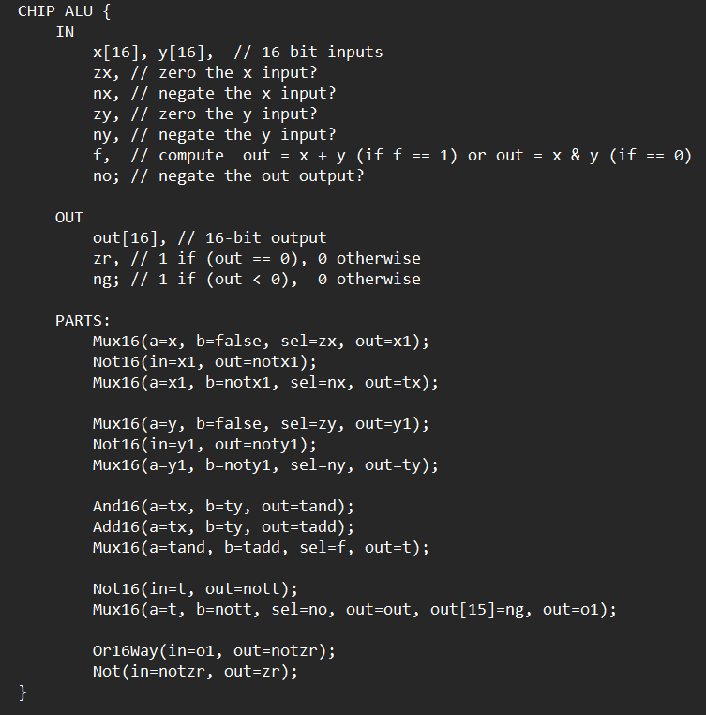

Slide 25
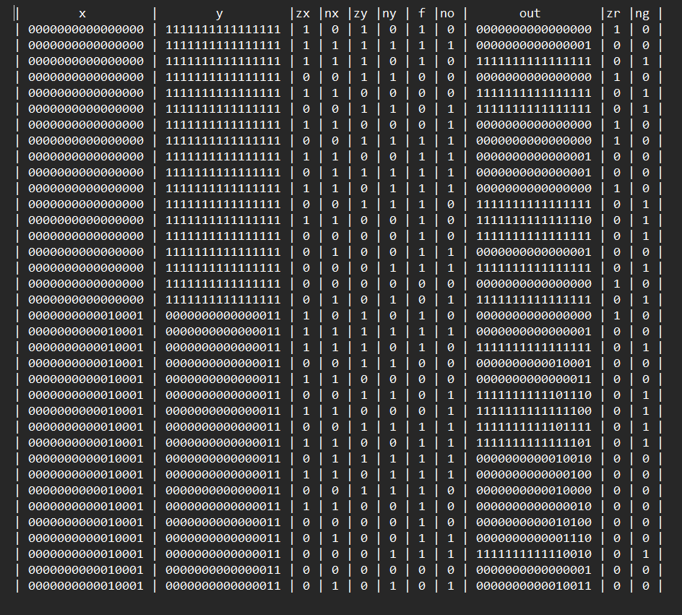

Slide 26
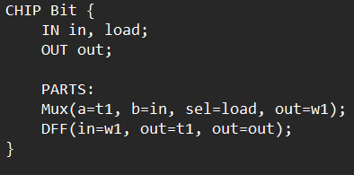
BIT

Slide 27
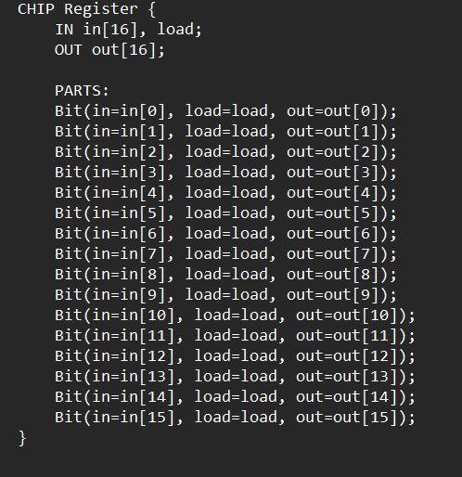
REGISTER

Slide 28
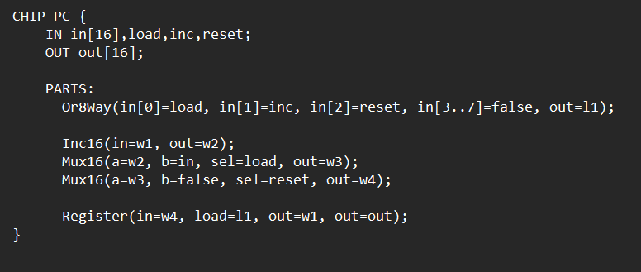
PC

Slide 29
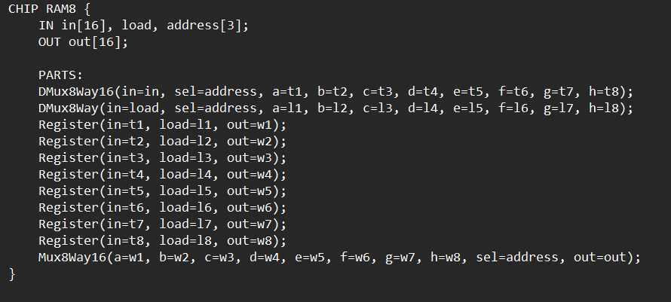
RAM8

Slide 30
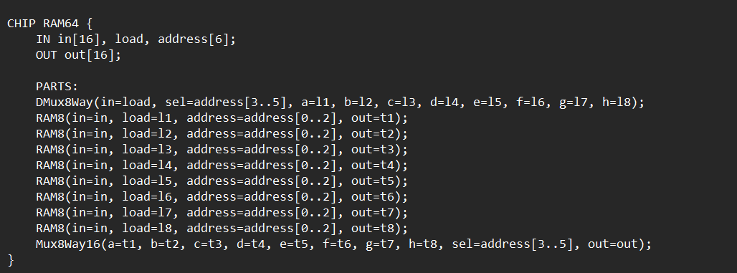
RAM64

Slide 31
RAM64

Slide 32
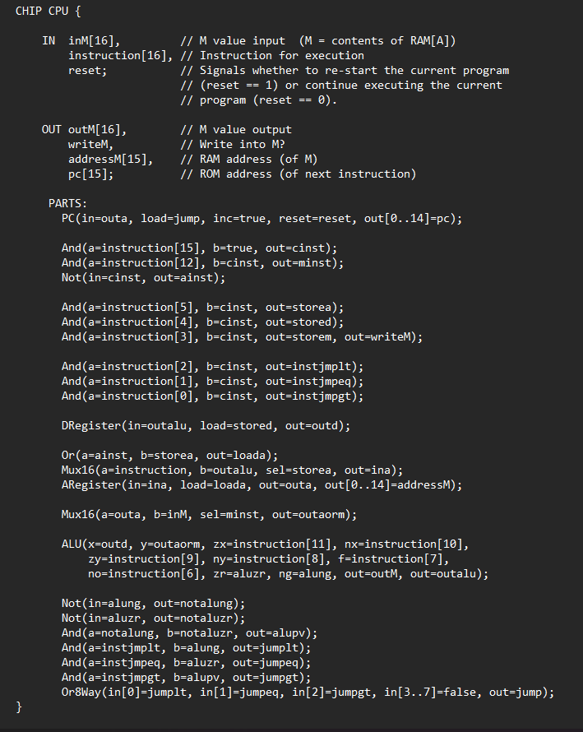
HACK CPU

Slide 33
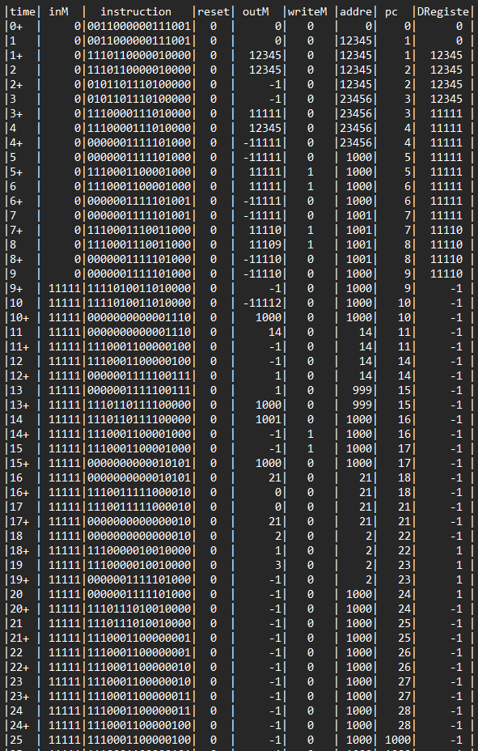
OUTPUT

Slide 34
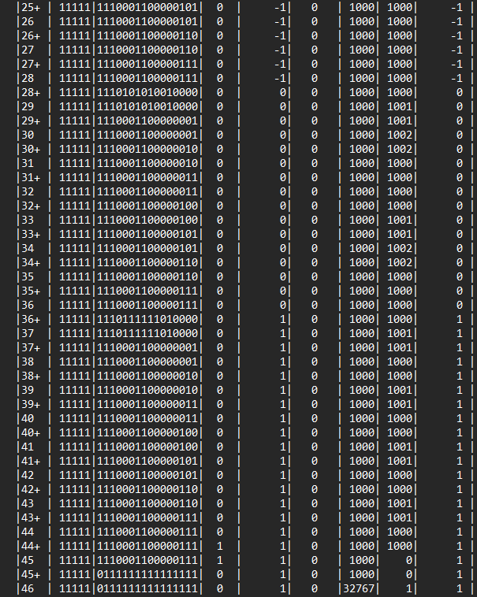

Slide 35
PART -B
Design and implement a synchronous counter that count down from decimal digit 9 onwards to 0

Slide 36
A 4-bit 9-0 Synchronous Counter is a digital circuit that counts in a binary sequence from 9 to 0 and then resets to 0, essentially counting decimal digits from 9 to 0. It’s built using flip-flops, which change states in synchronization with the clock signal, ensuring all bits update at the same time. Synchronous counters have several advantages over asynchronous counters, including reduced propagation delays and increased reliability at higher clock frequencies. These counters find applications in digital clocks, timers, and other devices requiring precise counting. This project aims to design and implement a 4-bit synchronous counter that limits the counting to a range from 9 to 0 (binary sequence 1001 to 0000). Such a counter is also known as a decade counter because it counts ten states. Beyond the zeroth count (0000), the counter resets to zero on the next clock pulse.
Introduction

Slide 37
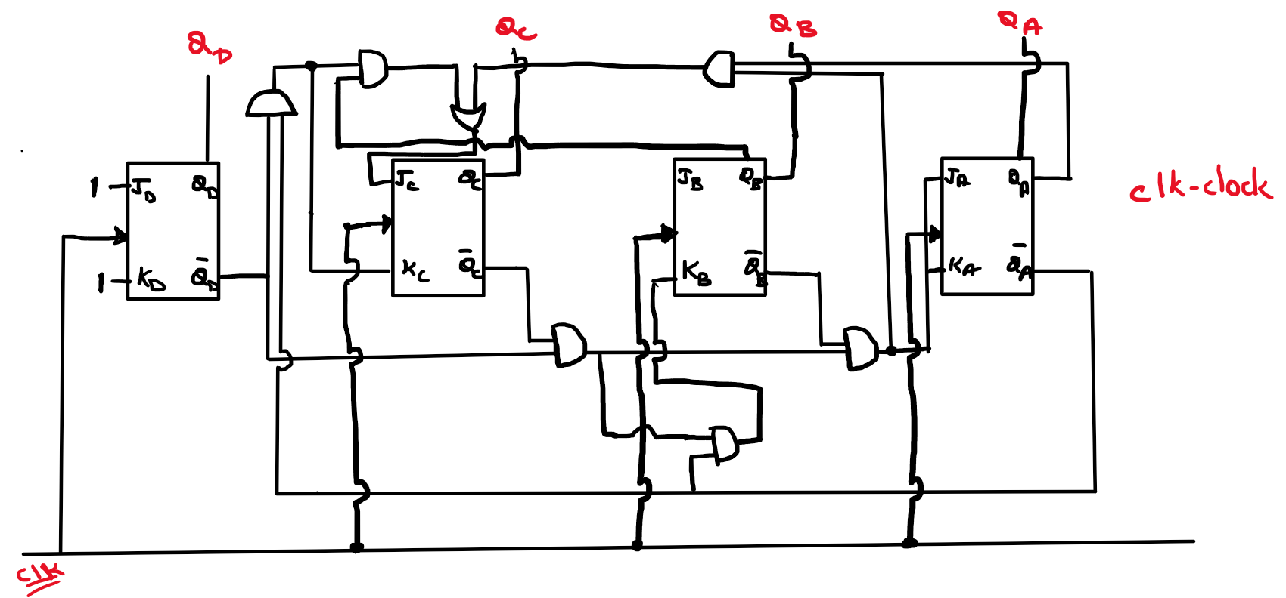
BLOCK DIAGRAM FOR MOD-10 SYNCHRONOUS DOWN COUNTER

Slide 38
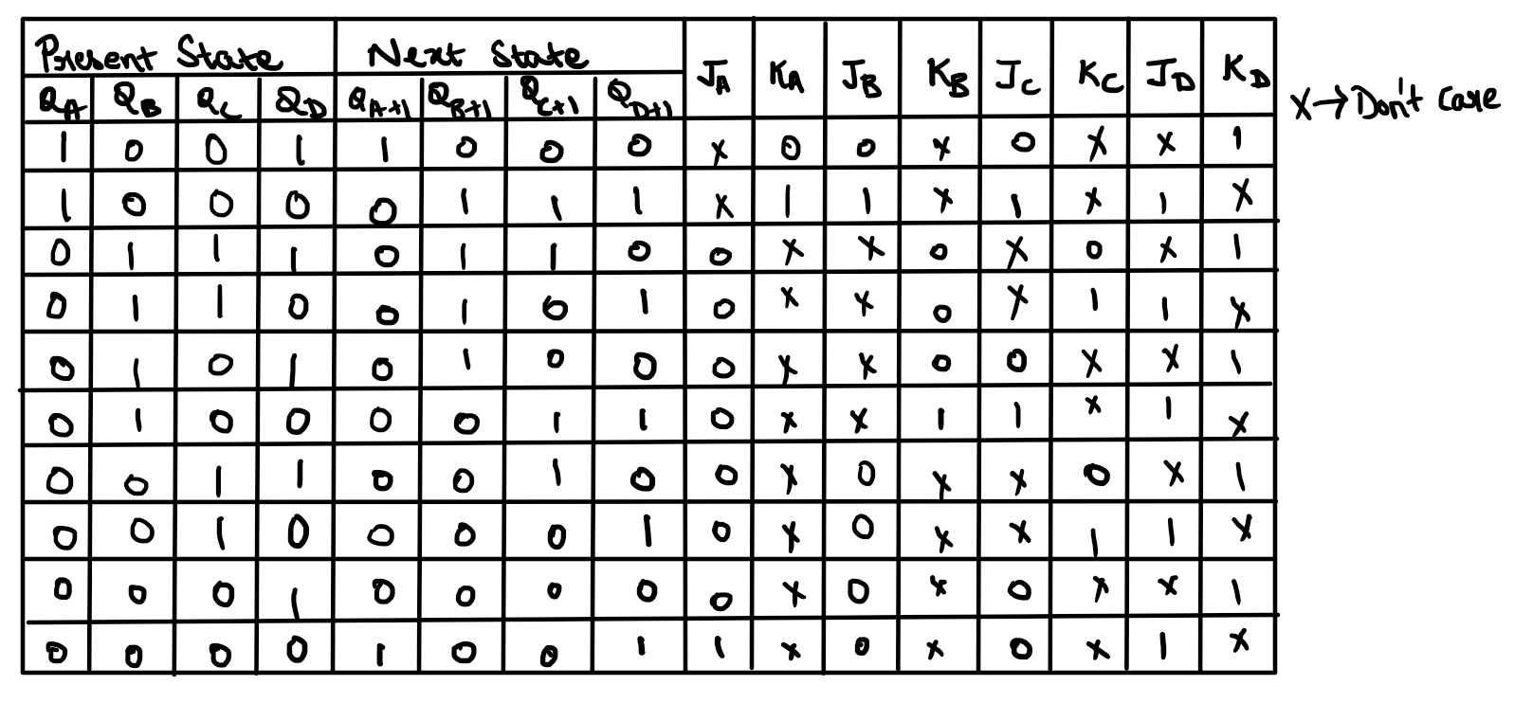
TRUTH TABLE

Slide 39
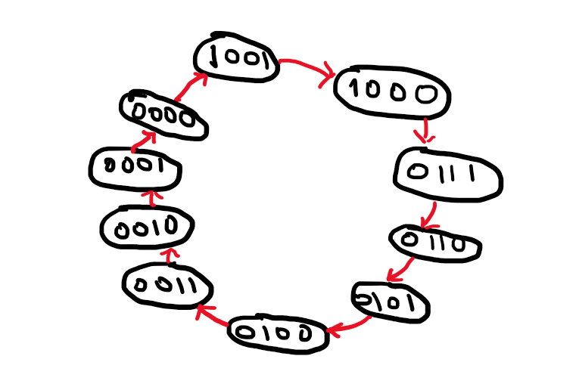
STATE DIAGRAM

Slide 40
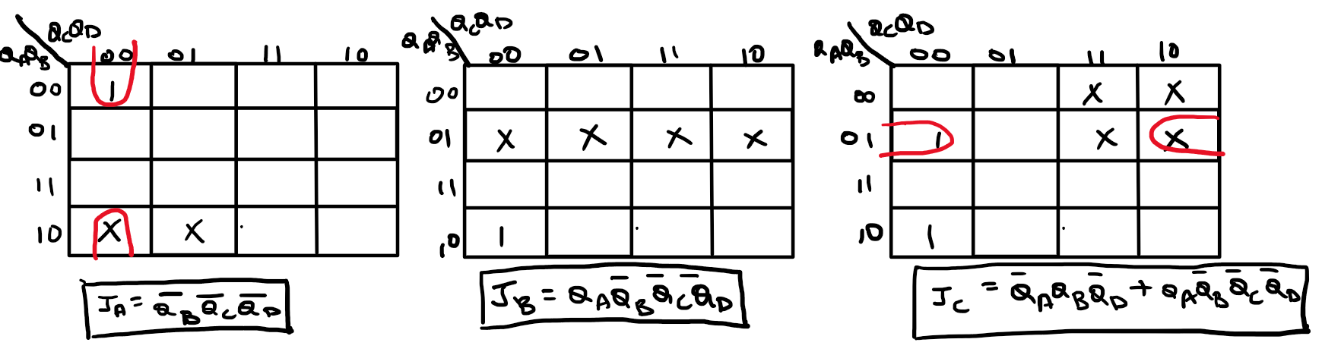
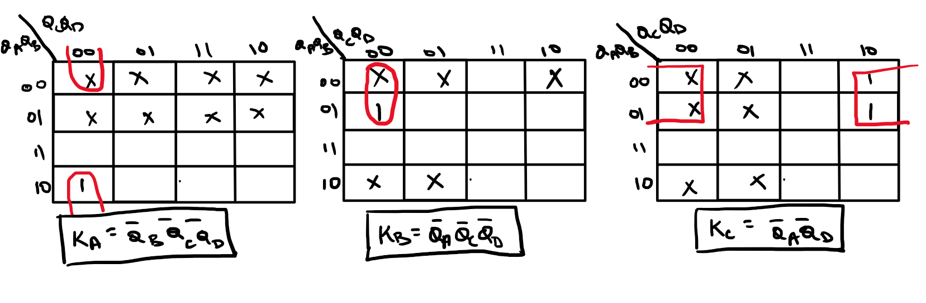
K-MAPS

Slide 41
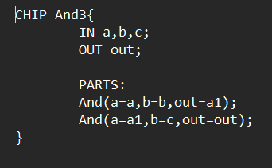
AND3

Slide 42
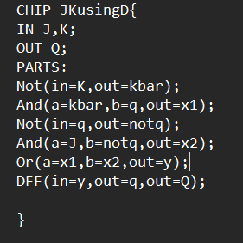
JK FLIP FLOP USING D FLIP FLOP

Slide 43
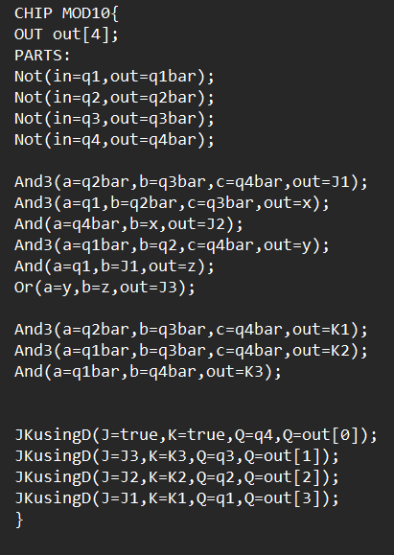
MOD10 / SYNCHRONOUS COINTER FOR 9 TO 0

Slide 44
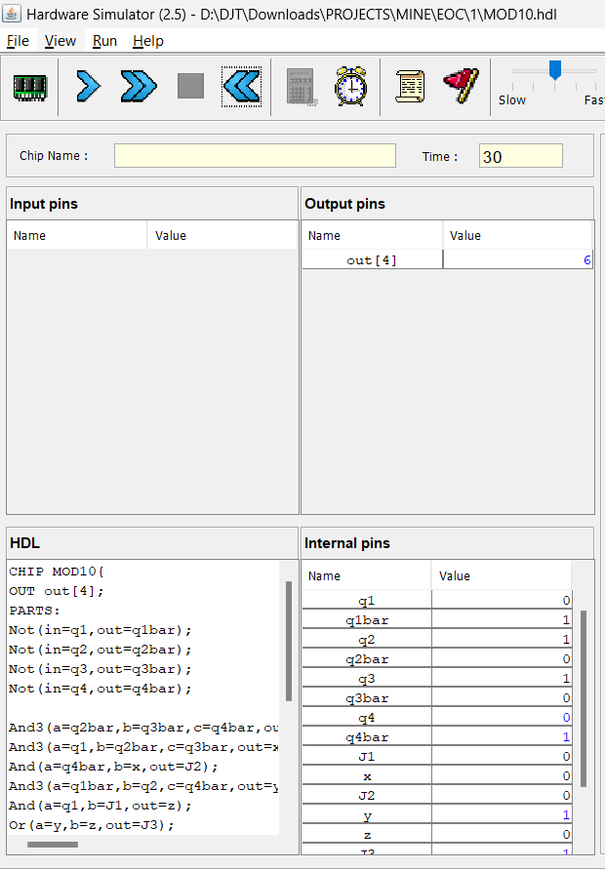
OUTPUT

Slide 45
CONCLUSION
Thus, we have designed and implemented HACK CPU and a synchronous counter that counts from decimal digit 9 to 0

Slide 46
THANK YOU!

